Slide 1
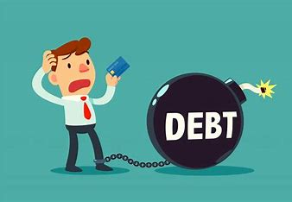
Company Bankruptcy Prediction
Project By: Arti Yadav
www.linkedin.com/in/arti-yadav-428b11229

Slide 2

Introduction
Bankruptcy or business failure can have a negative impact on both the business itself and the global economy. Business practitioners, investors, governments, and academic researchers have long studied ways to identify the risk of business failure in order to reduce the economic damage caused by bankruptcy.

Slide 3

Problem Statement
The goal of this machine learning project is to develop a predictive model that can assess the financial health of companies and predict the likelihood of bankruptcy based on various financial attributes. The dataset contains a wide range of financial indicators for different companies, including profitability ratios, liquidity ratios, leverage ratios, and operational efficiency metrics. The prediction of bankruptcy is a phenomenon of increasing interest in firms that stand to lose money because of unpaid debts

Slide 4

Purpose
Generally, the goal is to predict the likelihood that a company might go bankrupt. Financial institutions are in need of effective predictive models to make appropriate lending decisions.

Slide 5
Project Structure
Data Preprocessing
Exploratory Data Analysis (EDA) - Pandas/Numpy
Data Modification
Data Visualization
Feature Selection
Model Selection and Training
Model Evaluation using ML Algorithms for Bankruptcy Prediction
Classification Report and Accuracy Explaination

Slide 6
Variable Discription
ROA(C) %before interest and depreciation after-tax: Return On Total Assets(C)
ROA(A) % before interest and depreciation after-tax: Return On Total Assets(A)
ROA(B) % before interest and depreciation after tax: Return On Total Assets(B)
Operating Gross Margin: Gross Profit/Net Sales
Realized Sales Gross Margin: Realized Gross Profit/Net Sales
Operating Profit Rate: Operating Income/Net Sales
Pre-tax net Interest Rate: Pre-Tax Income/Net Sales
After-tax net Interest Rate: Net income/Net Sales
Non-industry Income and expenditure/revenue: Net Non-operating Income Ratio
Continuous interest rate (after tax): Net Income-Exclude Disposal Gain or Loss/Net Sales
Operating Expense Rate: Operating Expenses/Net Sales
Research and development expense rate: (Research and Development Expenses)/Net Sales
Cash flow rate Cash Flow from Operating/Current Liabilities

Slide 7
Interest-bearing debt interest rate: Interest-bearing Debt/Equity
Tax rate (A): Effective Tax Rate
Net Value Per Share (B): Book Value Per Share(B)
Net Value Per Share (A): Book Value Per Share(A)
Net Value Per Share (C): Book Value Per Share(C)
Persistent EPS(Earning Per share) in the Last Four quarters : EPS-Net Income
Cash Flow (Movement of money in and out)Per Share
Revenue Per Share (Euro): Sales Per Share
Operating Profit Per Share (Euro): Operating Income Per Share
Per Share Net profit before tax (Euro): Pretax Income Per Share
Realized Sales Gross Profit Growth Rate (%)
Operating Profit Growth Rate: Operating Income Growth(%)
After-tax Net Profit Growth Rate: Net Income Growth.(%)
Regular Net Profit Growth Rate: Continuing Operating Income after Tax Growth(%)

Slide 8
Continuous Net Profit Growth Rate(%): Net Income-Excluding Disposal Gain or Loss Growth
Total Asset Growth Rate(%). Total Asset Growth
Net Value Growth Rate(%): Total Equity Growth Total Asset Return Growth Rate Ratio%: Return on Total Asset Growth
Cash Reinvestment %: Cash Reinvestment Ratio(is a valuation ratio used to measure the percentage of annual cash flow that the company invests back into the business as a new investment.)
Current Ratio- CAssest/CLiabilities(a liquidity ratio that measures a company's ability to pay short-term obligations or those due within one year.)(>1.5 is a good ratio)
Quick Ratio: Acid Test (CAssets-Inventory/CLiabilities)
Interest Expense Ratio: Interest Expenses/Total Revenue
Total debt/Total net worth: Total Liability/Equity Ratio
Debt ratio %: Liability/Total Assets
Net worth/Assets: Equity/Total Assets
Long-term fund suitability ratio (A): (Long-term Liability+ Equity)/Fixed Assets
Borrowing dependency. Cost of Interest-bearing Debt
Contingent liabilities/Net worth: Contingent Liability/Equity (Loss may be in the future due to the current situation

Slide 9
Operating profit/Paid-in capital: Operating Income/Capital
Net profit before tax/Paid-in capital: Pretax Income/Capital (profit obtained by the current core operations)
Inventory and accounts receivable/Net value: (Inventory Accounts Receivables)/Equity- ( Inventory consists of the products you sell to customers. Receivables, or accounts receivable, are the outstanding balances you have yet to collect for sales made on credit.)
Total Asset Turnover. how effectively banks are using their assets to generate sales.
Accounts Receivable Turnover
Average Collection Days: Days Receivable Outstanding
Inventory Turnover Rate (times) -Cost of Goods Sold (COGS) / Average Inventory
Fixed Assets Turnover Frequency-Revenue / Average Fixed Assets
Net Worth Turnover Rate (times): Equity Turnover -Revenue / Average Shareholders' Equity
Revenue per person: Sales Per Employee-Total Revenue / Number of Employees
Operating profit per person: Operation Income Per Employee-Operating Income / Number of Employees
Allocation rate per person: Fixed Assets Per Employee–Total Fixed Assets / Number of Employees
Working Capital to Total Assets-Working Capital / Total Assets

Slide 10
Quick Assets/Total Assets - assets that can be quickly converted into cash, relative to its total assets.
Current Assets/Total Assets-assets expected to be converted into cash or used up within one year.
Cash/Total Assets-This ratio measures the proportion of a company's total assets that are held in the form of cash.
Quick Assets/Current Liability-This ratio measures the company's ability to cover its current liabilities using its quick assets.
Cash/Current Liability-This ratio measures the company's ability to cover its current liabilities using its cash reserves.
Current Liability to Assets-This ratio measures the proportion of a company's total assets that are financed by its current liabilities
Operating Funds to Liability-This ratio measures the company's operating funds relative to its total liabilities.
Inventory/Working Capital-This ratio measures the proportion of a company's working capital that is tied up in inventory.
Inventory/Current Liability-This ratio measures the proportion of a company's current liabilities that are covered by its inventory.
Current Liabilities/Liability-This ratio measures the proportion of a company's total liabilities that are classified as current liabilities.
Working Capital/Equity-This ratio measures the proportion of a company's equity that is represented by its working capital.

Slide 11
Current Liabilities/Equity-This ratio measures the proportion of a company's equity that is represented by its current liabilities.
Long-term Liability to Current Assets-This ratio measures the proportion of a company's current assets that are financed by its long-term liabilities.
Retained Earnings to Total Assets-This ratio measures the proportion of a company's total assets that are financed by its retained earnings.
Total income/Total expense-This ratio, often referred to as the income-to-expense ratio, measures the relationship between total income and total expenses
Total expense/Assets-This ratio measures the proportion of a company's assets that are used to cover its total expenses.
Current Asset Turnover Rate: Current Assets to Sales-This ratio measures how efficiently a company uses its current assets to generate sales revenue.
Quick Asset Turnover Rate: Quick Assets to Sales-This ratio measures how efficiently a company uses its quick assets to generate sales revenue
Working Capital Turnover Rate: Working Capital to Sales -This ratio measures how efficiently a company uses its working capital to generate sales revenue.
Cash Turnover Rate: Cash to Sales-This ratio measures how efficiently a company uses its cash to generate sales revenue.
Cash Flow to Sales-This ratio measures the proportion of sales revenue that is converted into cash flow.

Slide 12
Fixed Assets to Assets-This ratio measures the proportion of a company's total assets that are represented by fixed assets.
Current Liability to Liability-This ratio measures the proportion of a company's total liabilities that are classified as current liabilities.
Current Liability to Equity-This ratio measures the proportion of a company's equity that is represented by its current liabilities
Equity to Long-term Liability-This ratio measures the proportion of a company's long-term liabilities that are covered by its equity.
Cash Flow to Total Assets-This ratio measures the proportion of a company's total assets that are generated as cash flow.
Cash Flow to Liability-This ratio measures the proportion of a company's total liabilities that are covered by its cash flow.
CFO to Assets (calculated by dividing cash flows from operations by the average total assets.)-This ratio measures the efficiency of a company in generating cash flows from its operations relative to its total assets.
Cash Flow to Equity (Free cash flow to equity is composed of net income, capital expenditures, working capital, and debt)-This ratio, specifically Free Cash Flow to Equity (FCFE), measures the cash flow available to the equity holders of the company after accounting for all expenses, reinvestments, and debt obligations.

Slide 13
Current Liability to Current Assets-This ratio measures the proportion of a company's current assets that are financed by its current liabilities.
Liability-Assets Flag: 1 if Total Liability exceeds Total Assets, otherwise 0
Net Income to Total Assets
Total assets to GNP price ratio- Gross National Product(GNP is an economic indicator that measures the size and health of a country's economy.)
No-credit interval
Gross Profit to Sales
Net Income to Stockholder's Equity ratio
Liability to Equity ratio-This ratio measures the proportion of a company's total liabilities to its shareholders' equity.
Degree of Financial Leverage (DFL) ratio(It shows how much a percentage change in EBIT will result in a percentage change in EPS.)-DFL is an important metric for investors and analysts to assess a company's financial risk and understand how changes in operating performance can affect its profitability.
Interest Coverage Ratio (Interest expense to EBIT)-The Interest Coverage Ratio measures the company's ability to meet its interest obligations on outstanding debt.
Equity to Liability.The Equity to Liability Ratio, also known as the Equity Ratio, measures the proportion of a company's total assets that are financed by its shareholders' equity.
Bankrupt Class label 1: Yes, 0: No – Target Column

Slide 14
Summary of the Project
The dataset contains 6,819 observations with 94 features.
The target variable is " Bankrupt ", which is a binary variable indicating whether the company might go bankrupt or not.
The goal of the project is to develop a model to predict the likelihood that a company might go bankrupt and identify key factors contributing to bankruptcy.
The project will involve exploratory data analysis, feature engineering, and building and evaluating machine learning models.
Potential benefits of the project include reducing companies chances of getting bankrupt and cost savings for companies.

Slide 15
Exploratory Data Analysis
Exploratory Data Analysis (EDA) is a fundamental step in data science projects. It involves studying and exploring datasets to understand their key characteristics, discover patterns, identify outliers, and reveal relationships between variables. Here are the primary goals of EDA:
Data Cleaning:
some column name has an excess of '?' symbols, so this symbol needs to be removed for the appropriate column name.
We don’t have any missing data , duplicate values in dataset, it is already pre-processed.
Descriptive Statistics:
EDA uses statistical measures (e.g., mean, median, standard deviation, range) to understand variable tendencies, variability, and distributions.
Min. value of most variable is 0 and max. value is 1.
We can conclude that all variables are scaled.
Data Visualization:
Visual techniques (histograms, countplot , scatter plots, etc.) represent data graphically.
These visualizations help identify trends, patterns, and relationships.

Slide 16
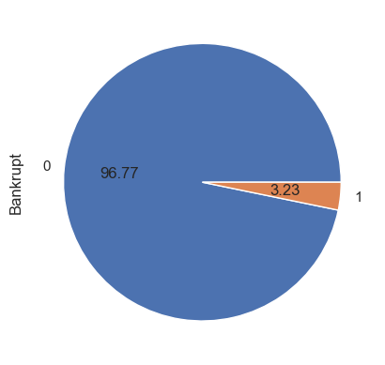
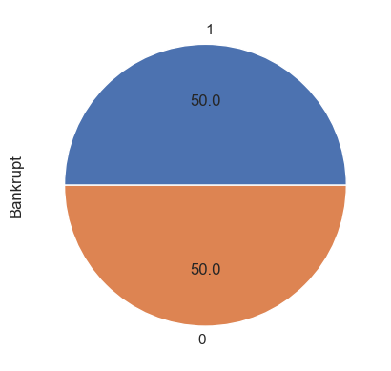
Handling Imbalanced Data
By SMOTE (Synthetic Minority Oversampling Technique)
BEFORE
AFTER
SMOTE addresses this issue by oversampling the minority class.
Instead of simply duplicating existing examples from the minority class (which doesn’t add new information), SMOTE synthesizes new examples.
These synthetic examples lie along the decision boundary, effectively augmenting the minority class.

Slide 17

Model Selection and Training
Machine Learning Models are mathematical representations. In other words ,they are the output we receive after training a process.
What Machine Learning model does is discover the patterns in a training dataset. In other words,machine learning model map inputs to the outputs of the given dataset
We have build models with different approaches:
Without Dimensionality Reduction
With Dimensionality Reduction
With Mutual Info Classif
Models Used are:
1. Logistic Regression
2. K-Nearest Neighbors
3. Decision Tree
4. Naive Bayes
5. Random Forest
6. XG Boosting
7. PCA

Slide 18
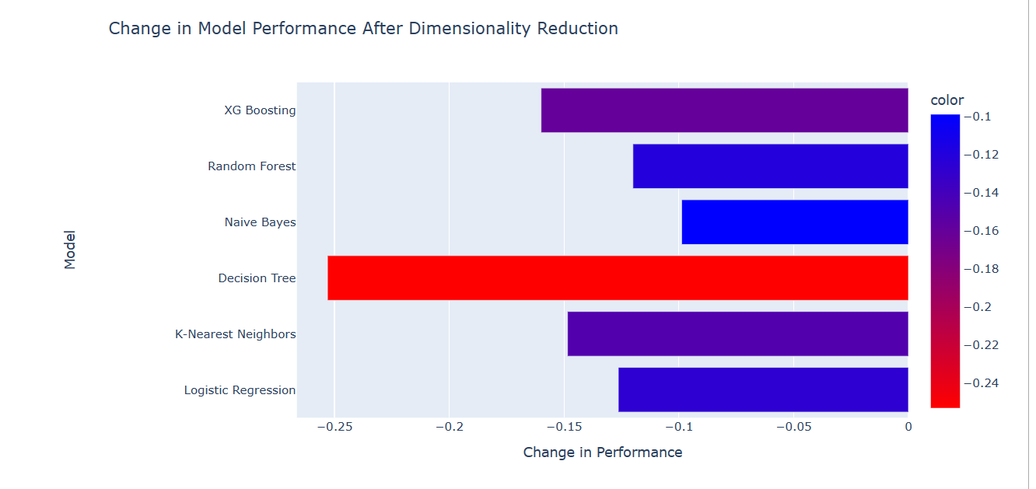
Without Dimensionality Reduction Models Accuracy:
Logistic Regression: 90.94%
K-Nearest Neighbors: 97.24%
Decision Tree: 95.42%
Naive Bayes: 73.06%
Random Forest: 97.67%
XG Boosting: 98.36%
With Dimensionality Reduction Models Accuracy:
Logistic Regression: 78.30%
K-Nearest Neighbors: 82.39%
Decision Tree: 70.12%
Naive Bayes: 63.18%
Random Forest: 85.67%
XG Boosting: 82.36%

Slide 19
We found that models without dimensionality reduction have good accuracy than the models with dimensionality reduction.
We will consider models without dimensionality reduction as it has better accuracy & F1 score.
Most models have very high Accuracy, all over 90%.
However, the model with the highest Accuracy is Random Forest (97.67%) & XGBoosting(98.36%) .
Before forcasting any model ,lets check the ROC-AUC Score.

Slide 20
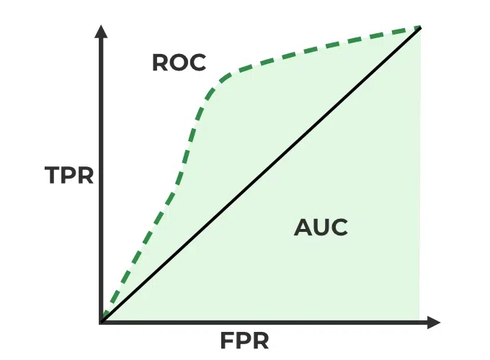
Model Evaluation
Receiver Operating Characteristics (ROC ) Curve
ROC stands for Receiver Operating Characteristics, and the ROC curve is the graphical representation of the effectiveness of the binary classification model. It plots the true positive rate (TPR) vs the false positive rate (FPR) at different classification thresholds.
Area Under Curve (AUC ) Curve:
AUC stands for the Area Under the Curve, and the AUC curve represents the area under the ROC curve. It measures the overall performance of the binary classification model. As both TPR and FPR range between 0 to 1, So, the area will always lie between 0 and 1, and A greater value of AUC denotes better model performance. Our main goal is to maximize this area in order to have the highest TPR and lowest FPR at the given threshold. The AUC measures the probability that the model will assign a randomly chosen positive instance a higher predicted probability compared to a randomly chosen negative instance.
It represents the probability with which our model can distinguish between the two classes present in our target.

Slide 21
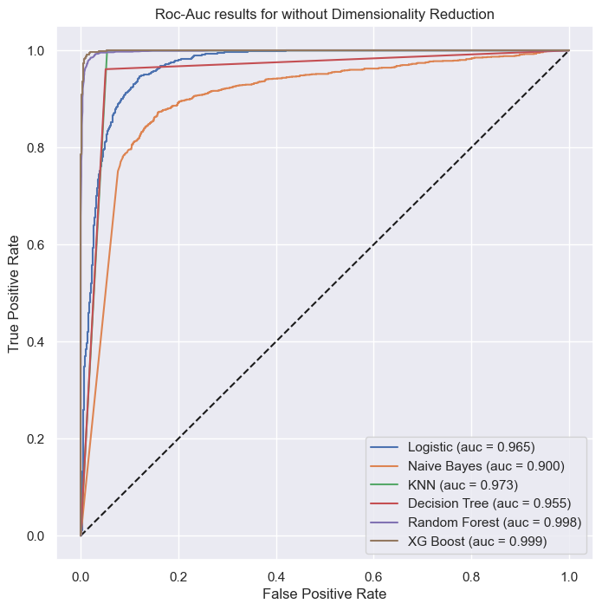
The higher the AUC, the better the model’s performance at distinguishing between the positive and negative classes.
A greater value of AUC denotes better model performance.
All the models having AUC aboove 0.9 ,indicates that all models are performing well.

Slide 22
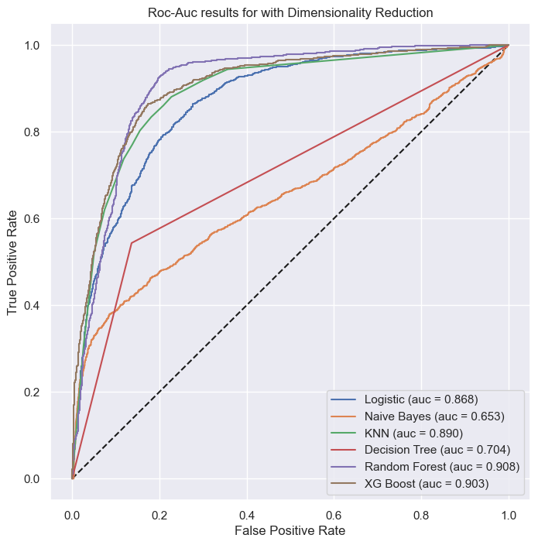
All the models having low AUC score as compare to models without dimensionality reduction.
The AUC score of Logisitic Regression, Random Forest and XG Boost are better than rest all models.
These Models are performing well.

Slide 23
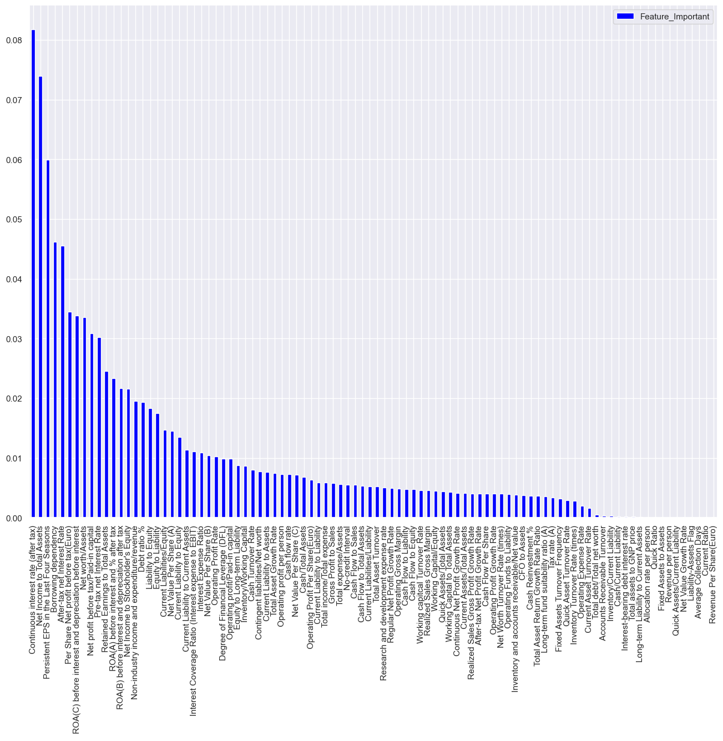
IMPORTANT Feature
The order of features that affect Bankrupt is sorted from high to low. The 10 high-impact features include:
Continuous interest rate (after tax)
Net Income to Total Assets
Persistent EPS in the Last Four Seasons
Borrowing dependency
After-tax net Interest Rate
Per Share Net profit before tax(Euro)
ROA(C) before interest and depreciation before interest
Net worth/Assets
Net profit before tax/Paid-in capital
Pre-tax net Interest Rate

Slide 24
Key Performance Indicator:
We have build models with two approaches:
Without Dimensionality Reduction
With Dimensionality Reduction
We found that models without dimensionality reduction have good accuracy than the models with dimensionality reduction.
We will consider models without dimensionality reduction as it has better accuracy & F1 score.
Most models have very high Accuracy, all over 90%.
However, the model with the highest Accuracy is Random Forest(auc = 99.8%) & XGBooster (auc = 99.9%).
Therefore, we choose these model to conduct forecasting.

Slide 25
Conclusion
In this analysis, some important results were found as follows:
The topic uses Machine Learning models to come up with the best model for predicting bankruptcy at companies.
The best model given is the Random forest & XGBooster.
The accuracy of the Random forest model is 97.67%. ROC is very high (auc = 99.8%).
The accuracy of the XGBooster model is 98.36%. ROC is very high (auc = 99.9%).
Top 10 features for Bankruptcy given by Random Forest Model:
Continuous interest rate (after tax)
Net Income to Total Assets
Persistent EPS in the Last Four Seasons
Borrowing dependency
After-tax net Interest Rate
Per Share Net profit before tax(Euro)
ROA(C) before interest and depreciation before interest
Net worth/Assets
Net profit before tax/Paid-in capital
Pre-tax net Interest Rate

Slide 26
Suggestion
Forecasts of corporate default are used in various sectors across the economy. Corporations can diagnose their current condition based on predictive models and establish their strategies. Executives can run their businesses more stably by managing key metrics that influence a company's default risk. Investors can modify their strategies and improve their portfolios by checking the company's likelihood of default.
Additionally, governments can establish macroprudential policies and improve related financial regulations using corporate default predictions. In these ways, default prediction models help design and improve financial systems.
Additionally, using machine learning algorithms and statistical models, corporate default predictions are at the forefront of advanced financial engineering. The recent global financial crisis and the increase in credit risk have further highlighted the importance of this sector. Because of their importance, corporate default predictions have been widely studied.

Slide 27
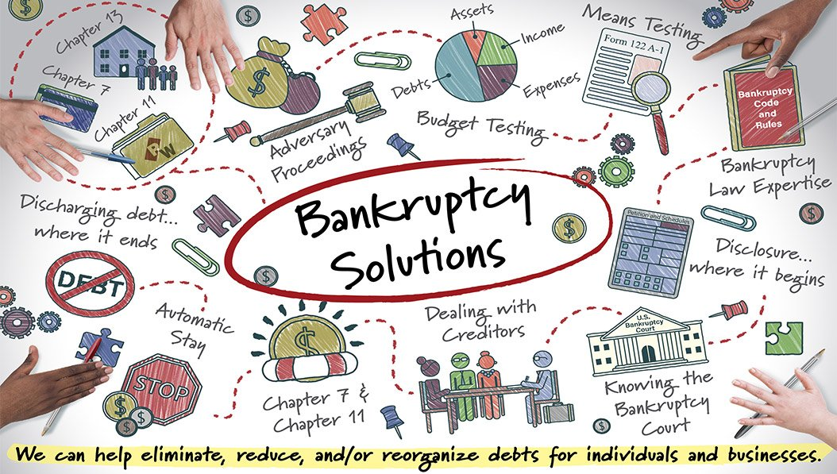
In short, building a model to predict default risk (or bankruptcy risk) is very important for every business. Therefore, when undertaking corporate default forecasting, it is necessary to choose an appropriate method that can provide appropriate information for forecasting purposes, which requires a thorough understanding of the appropriate use of each method.
THANK YOU……
https://drive.google.com/drive/folders/1QIbmMZqdKIFVEhYxLrFD1073g6P6PBOb?usp=drive_link

